Slide 1
Marketing Analytics
Muhammad Jawad Hassan

Slide 2

Introduction
Ifood is an Ecommerce company in Brazil. They wants to produce the highest profit for the next direct marketing campaign, scheduled for the next month.
For this reason, the CMO presented a small data of their previous marketing data to analyze trends and insights in these customers and to apply it to the rest of the customer base.

Slide 3
Business Problem
Customer Segmentation
Segment customers based on RFM (e.g., frequency, monetary value).
Analyze customer segments based on Average Income.
Sales Performance Analysis
Assess sales performance across different product categories (e.g., wines, fruits).
Analyze sales performance across different RFM Segments..
Campaign Effectiveness Evaluation
Evaluate the acceptance rates of different campaigns.
Identify which RFM segments respond best to different types of marketing campaigns..

Slide 4




Process
Data Cleaning
Analyzing Product Category
Checking missing values and removing duplicates (163 values).
Making a new column of CustomerID..
Analyizing Product Categories by Sales.
Visualize customer preferences across RFM segments.
Customer Segmentation
Campaign Effectiveness
The acceptance rates of different marketing campaigns were evaluated.
Comparing campaign performance with RFM segments.
Identifying Recency column. Making Frequency and Monetary columns.
Creating new dataframe for RFM.

Slide 5
RFM Segmentation
Receny Frequency Monetary
48.88
607.7
Avg. Of Recency
Avg. Of Monetary
14.90
2021
Avg. Of Frequency
Total Customers

Slide 6

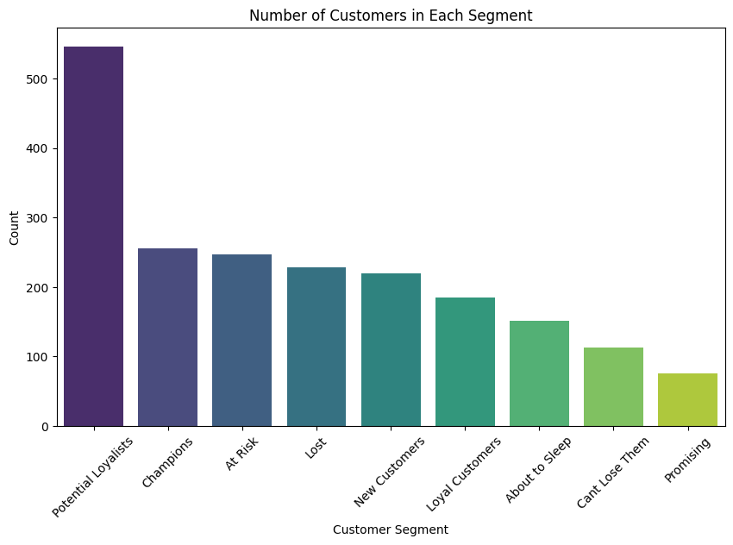
NUMBER OF CUSTOMERS IN EACH SEGMENT
Potential Loyalists: The highest count with approximately 550 customers.
Champions: A significant count, around 250 customers.
At Risk, Lost, New Customers: Moderate counts ranging from 200 to 250 customers.
Loyal Customers, About to Sleep: Lower counts, around 150 to 200 customers.
Can't Lose Them, Promising: The lowest counts, with less than 100 customers each.

Slide 7
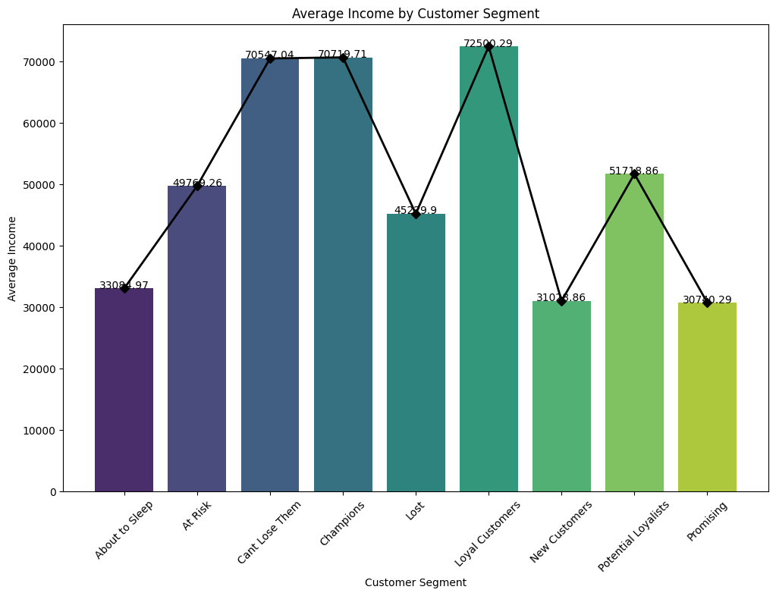
Average Income by RFM Segments
Loyal Customers exhibit the highest average income with an average income of 72500.29 USD.
Segments with higher average incomes (Champions, Loyal Customers,Can't Lose Them ) represent potential high-value customers.
About to sleep, new customers and promising have low average income.

Slide 8


Recommendations for RFM
Nurture Potential Loyalists, Champions and Loyal Customers with targeted campaigns and loyalty programs to encourage repeat purchases.
Launch re-engagement campaigns with personalized offers for At Risk customers to prevent churn.
Offer significant incentives and analyze reasons for churn to re-engage Lost customers.
Implement a robust onboarding process with welcome offers to convert New Customers into loyal ones.
Use Income Levels to personalize the campaigns.

Slide 9
Sales Performance by Product Category
06
$1.23M
Number of Category
Total Sales

Slide 10
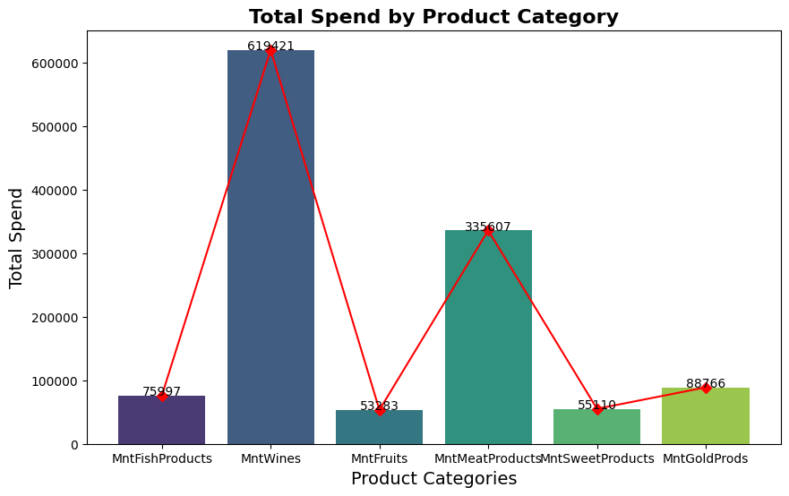
TOTAL SALES BY PRODUCT CATEGORIES
Wines is the top-performing product category with a total spend of 619,421 units, while Fruits is significantly underperforming with a total spend of 619,421 units.
Mid-range: The other categories' sales drop like this Meat Products, Gold Products, Fish Products and lastly Sweet Products.

Slide 11
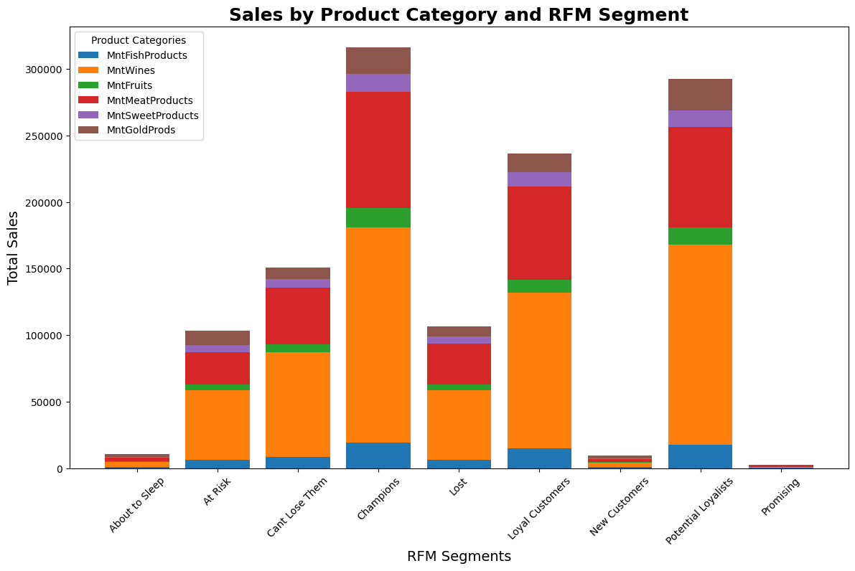
SALES BY PRODUCT CATEGORIES & RFM
Sales are highest for "Champions" and "Loyal Customers" across most product categories.
Wines consistently contributes the largest portion of sales to each RFM segment.
Fruits generally has the lowest sales across all segments.

Slide 12
Recommedations for Sales Performance
Focus on promoting Wines, as it is the top-performing product category, to maximize revenue.
Target Champions and Loyal Customers with premium product offerings and exclusive deals on Wines.
Increase marketing efforts for Meat Products, Gold Products, Fish Products, and Sweet Products to improve their performance.
Consider bundling Fruits with other popular products like Wines to drive up sales.
Develop strategies to boost the sales of Fruits, as it is significantly underperforming across all segments.

Slide 13
Marketing campaign analysis
05
Number of Campaigns
611
Number of Campaign Acceptance

Slide 14
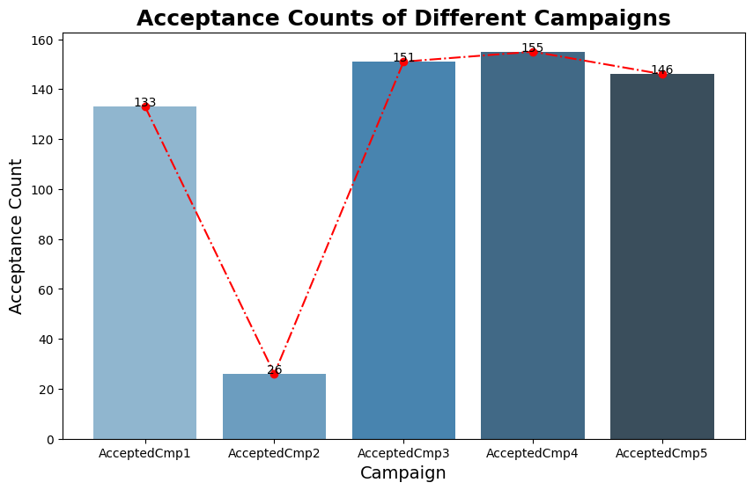
Campaign Performance
Highest: Campaign 4 with 155 acceptances. Lowest: Campaign 2 with 26 acceptances.
Mid-range: Campaign 1, Campaign 3, and Campaign 5 have acceptance counts 133, 151 and 146 respectively.

Slide 15
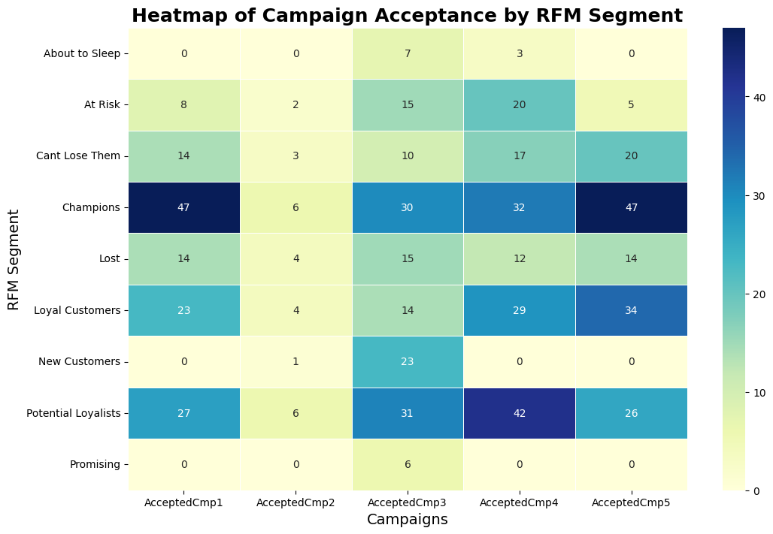
Campaign Performance & RFM Segment
Campaign 4 shows high acceptance rates across multiple RFM segments, particularly for "Champions" and "Loyal Customers."
Campaign 2 generally has lower acceptance rates compared to other campaigns.

Slide 16
Recommedations
Campaign 4 is the most successful, with 155 acceptances. Focus on understanding what made this campaign resonate, particularly with Champions and Loyal Customers.
Campaign 1, 3, and 5 have moderate success. They can be optimized by incorporating elements from Campaign 4 to boost their performance.
Prioritize future campaigns towards Champions and Loyal Customers, as they are more likely to engage with high-performing campaigns.
Learn what went wrong to Campaign 2 and explore opportunities to re-engage customers who did not respond to Campaign 2 with targeted offers or incentives.

Slide 17
Summary
By implementing these recommendations, IFOOD can expect a potential 10-15% increase in overall campaign performance.
Focusing on high-performing products like Wines could boost sales by 10%, while for underperforming categories may achieve a 5% sales increase.
Overall, these actions could contribute to a 7-10% increase in customer retention and a 12-15% rise in revenue from loyal segments, ultimately enhancing the company's financial performance and customer loyalty.

Slide 18
Thank you
Muhammad Jawad Hassan
Linkedin.com/in/jawad09

